Slide 1
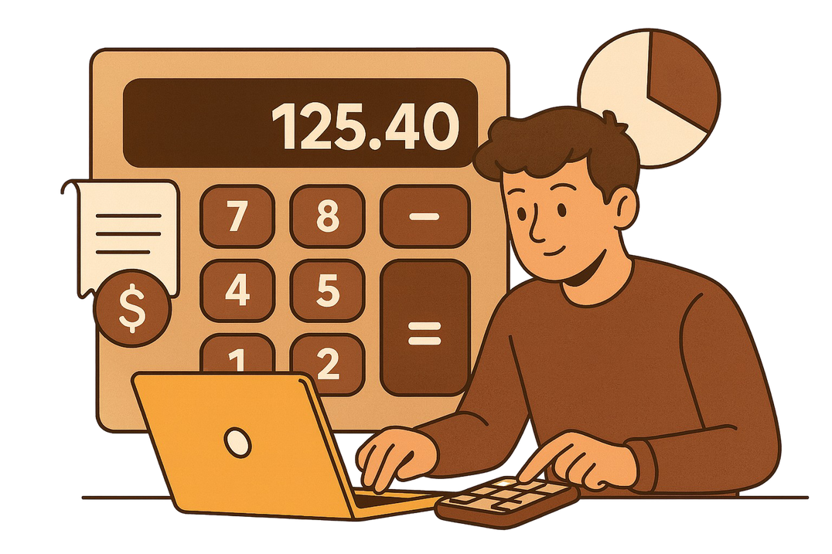
Zenith
DIVIDE DIME
Expense Splitting Calculator
Page 01

Slide 2



WHAT WE ARE SOLVING ?
Confusion in shared expenses, where people struggle to decide who owes how much.
Manual calculation mistakes, which lead to unfair or incorrect cost splitting.
Arguments and misunderstandings, by providing a clear and transparent payment breakdown.
Page 02

Slide 3
Divide Dime is a Python-based tool created to split shared expenses among a group in a simple and fair way.
PROJECT
DESCRIPTION
It takes inputs like the amount paid by each person and automatically calculates each individual's share
The project aims to reduce confusion and eliminate manual calculation errors in group expense management.
Page 03

Slide 4
Divide Dime provides a fair and accurate expense-splitting solution, removing confusion in group payments.
SOLUTION APPROACH !
It automatically calculates each person’s share, solving the problem of manual maths and disagreements.
The tool gives a clear final output showing who owes how much, making group expense management simple and transparent.
Page 04

Slide 5
APPLICATIONS...
Group Trips: Split travel, food, and activity expenses among friends easily.
Roommates: Manage shared costs like rent, groceries, and utilities without confusion.
Events & Outings: Quickly divide expenses for parties, office lunches, or group gatherings.
Page 05

Slide 6
INDIVIDUAL CONTRIBUTION
KRISHNA GARG ( TEAM LEADER )
Managed project structure & integration
PRITISH PANT ( BACKEND DEVELOPER )
BHAVYA ( UI/UX DESIGNER )
Built core Python calculation logic.
Designed interface layout
SHOURYA RATTAN DEVGAN
( DOCUMENTATION LEAD )
SHREYANSH PRASAD ( TESTING LEAD )
Tested code & fixed errors.
Prepared documentation & PPT.
Page 06

Slide 7
Thank You
Page 07

